Slide 1




Investigation on the Mental State of College Students
Reporter：王奕澄，郑章庆，丁嘉晖，郭琪，王宇涵

Slide 2
Table of contents
01
Background
02
Methods
03
Analysis and Results
04
Discussion

Slide 3



01
Background
Made and Presented by:王奕澄

Slide 4
我的精神挺好的呀
我的神好挺的精呀
神挺精呀我的好的
杀杀杀！！上勾拳！下勾拳！左勾拳！右勾拳！扫堂腿！回旋踢！这是蜘‬蛛吃耳屎，这是龙卷摧风‬毁停车场！这是羚‬羊蹬，这是山羊跳！乌鸦坐‬飞机！老鼠走迷宫！大象踢‬腿！愤怒的章鱼！巨斧砍大树！
彻底疯狂！彻底疯狂！彻底疯狂！彻底疯狂！彻底疯狂！彻底疯狂！

Slide 5
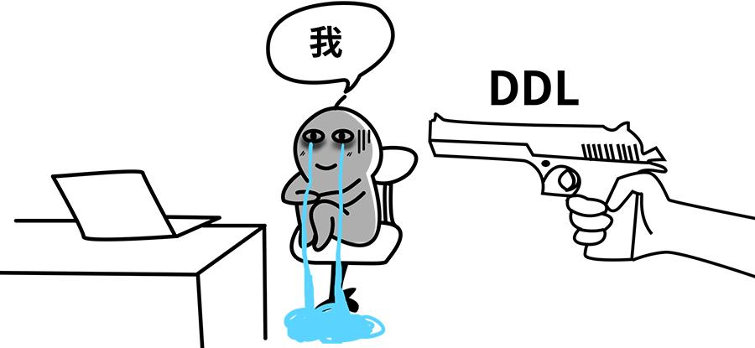
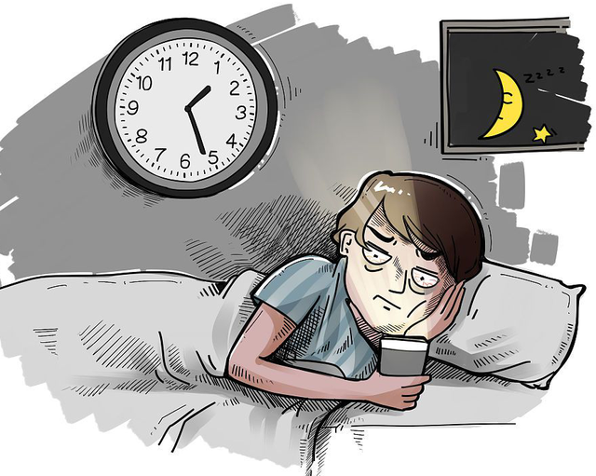

High Pressure of Studying
Lack of Sleep
Communication Barrier

Slide 6
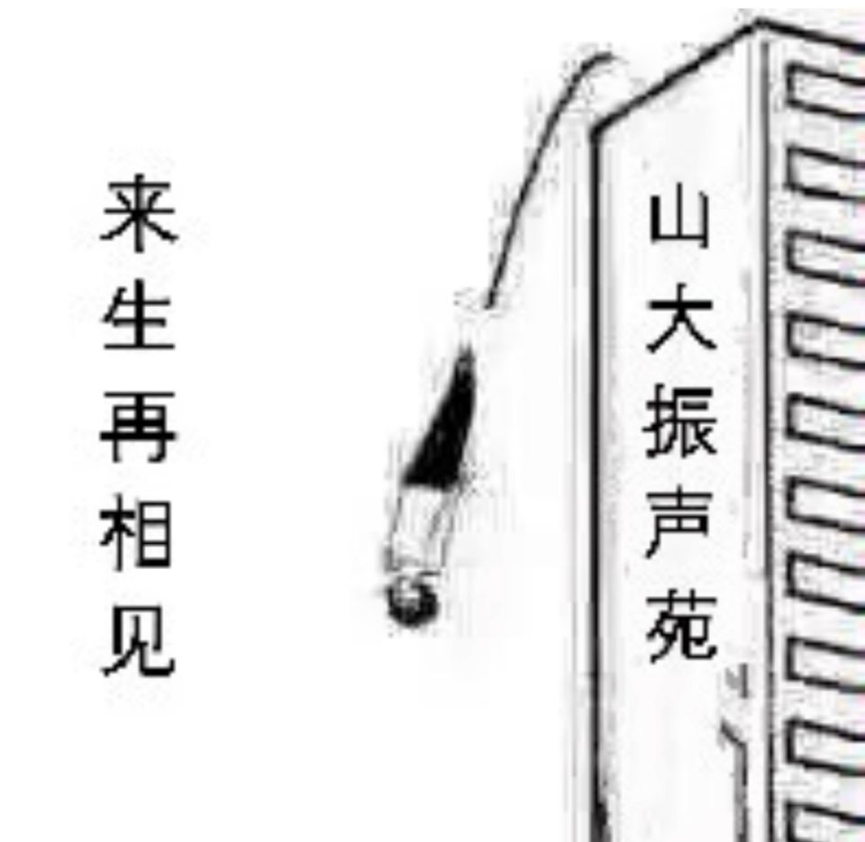
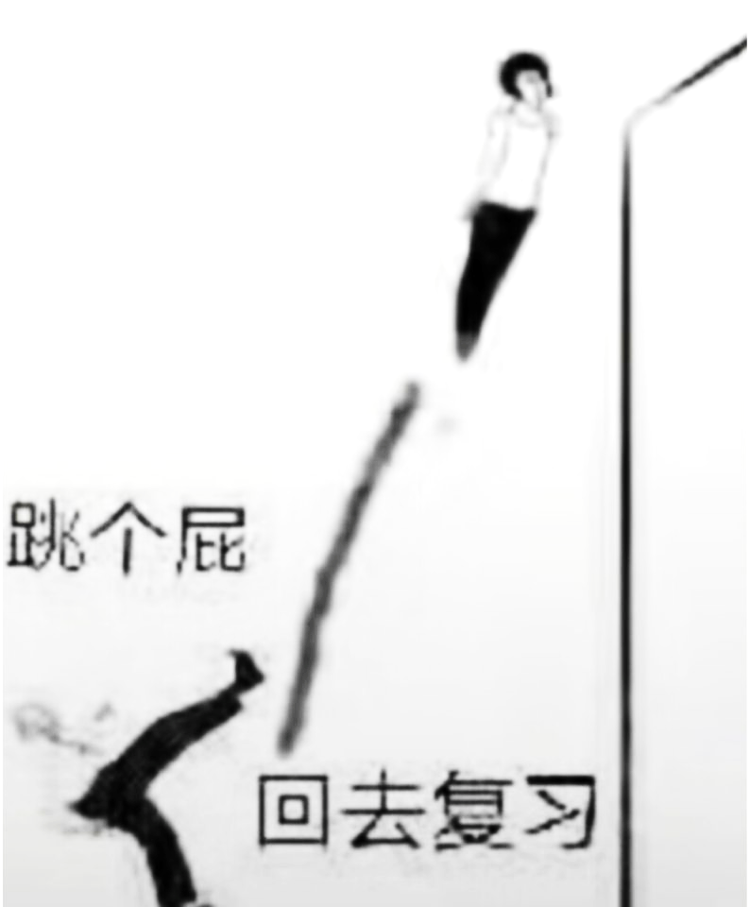
Suiside Tendency

Slide 7

The Generation Z

Slide 8

The 19th CPC National Congress
Strengthen the construction of the social psychological service system and cultivate a self-respecting, self-confident, rational, peaceful, and positive social mentality
Necessary and Imperative!

Slide 9




Methods
02
Made by :郑章庆

Slide 10
Table of contents
Data Acquisition
Data Ananlysis

Slide 11

Data Acquisition
Identify the Primary Influencing Factors
Design the Questions

Slide 12

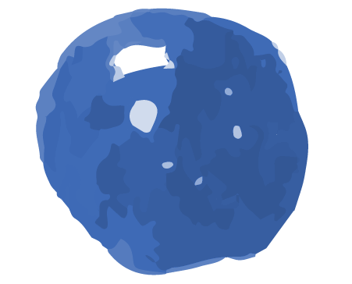


Identify the Primary Influencing Factors
01
03
02
04
Study Pressure
Sleep Quality
Dietary Habits
Interpersonal Relationships

Slide 13

Design the Questions
For clarity, we've crafted three questions for each of the four influencing factors based on following guidelines:
At least one self-assessment
At least one root cause analysis
Ensuring the questions are engaging
In reality, our questionnaire has 14 questions. The additional two questions are included to enhance engagement.

Slide 14
Data Ananlysis
Evaluate Overall Mental State
Analyze Different Influencing Factors

Slide 15

Evaluate Overall Mental State
Allocate Weights
Score the Overall Mental State
Derived from the Analytic Hierarchy Process (AHP)
Using simple weighted average

Slide 16
Introduction to AHP
AHP is a method for evaluating complex decisions with multiple objectives, using network theory to hierarchically analyze and mathematically process them with limited quantitative information.

Slide 17

Steps of Allocating Weights
Construct pairwise comparison matrices.
Perform consistency checks
1
2
3
Calculate weights

Slide 18
Score the Overall Mental State
Convert the status evaluation of each influencing factor into a score, then calculate the weighted average of the scores.

Slide 19

Analyze Different Influencing Factors
Cross-analysis, or three-dimensional analysis, combines longitudinal and lateral methods, progressing from basic to advanced.

Slide 20

Analysis& Result
03
Made by 丁嘉晖，郭琪

Slide 21
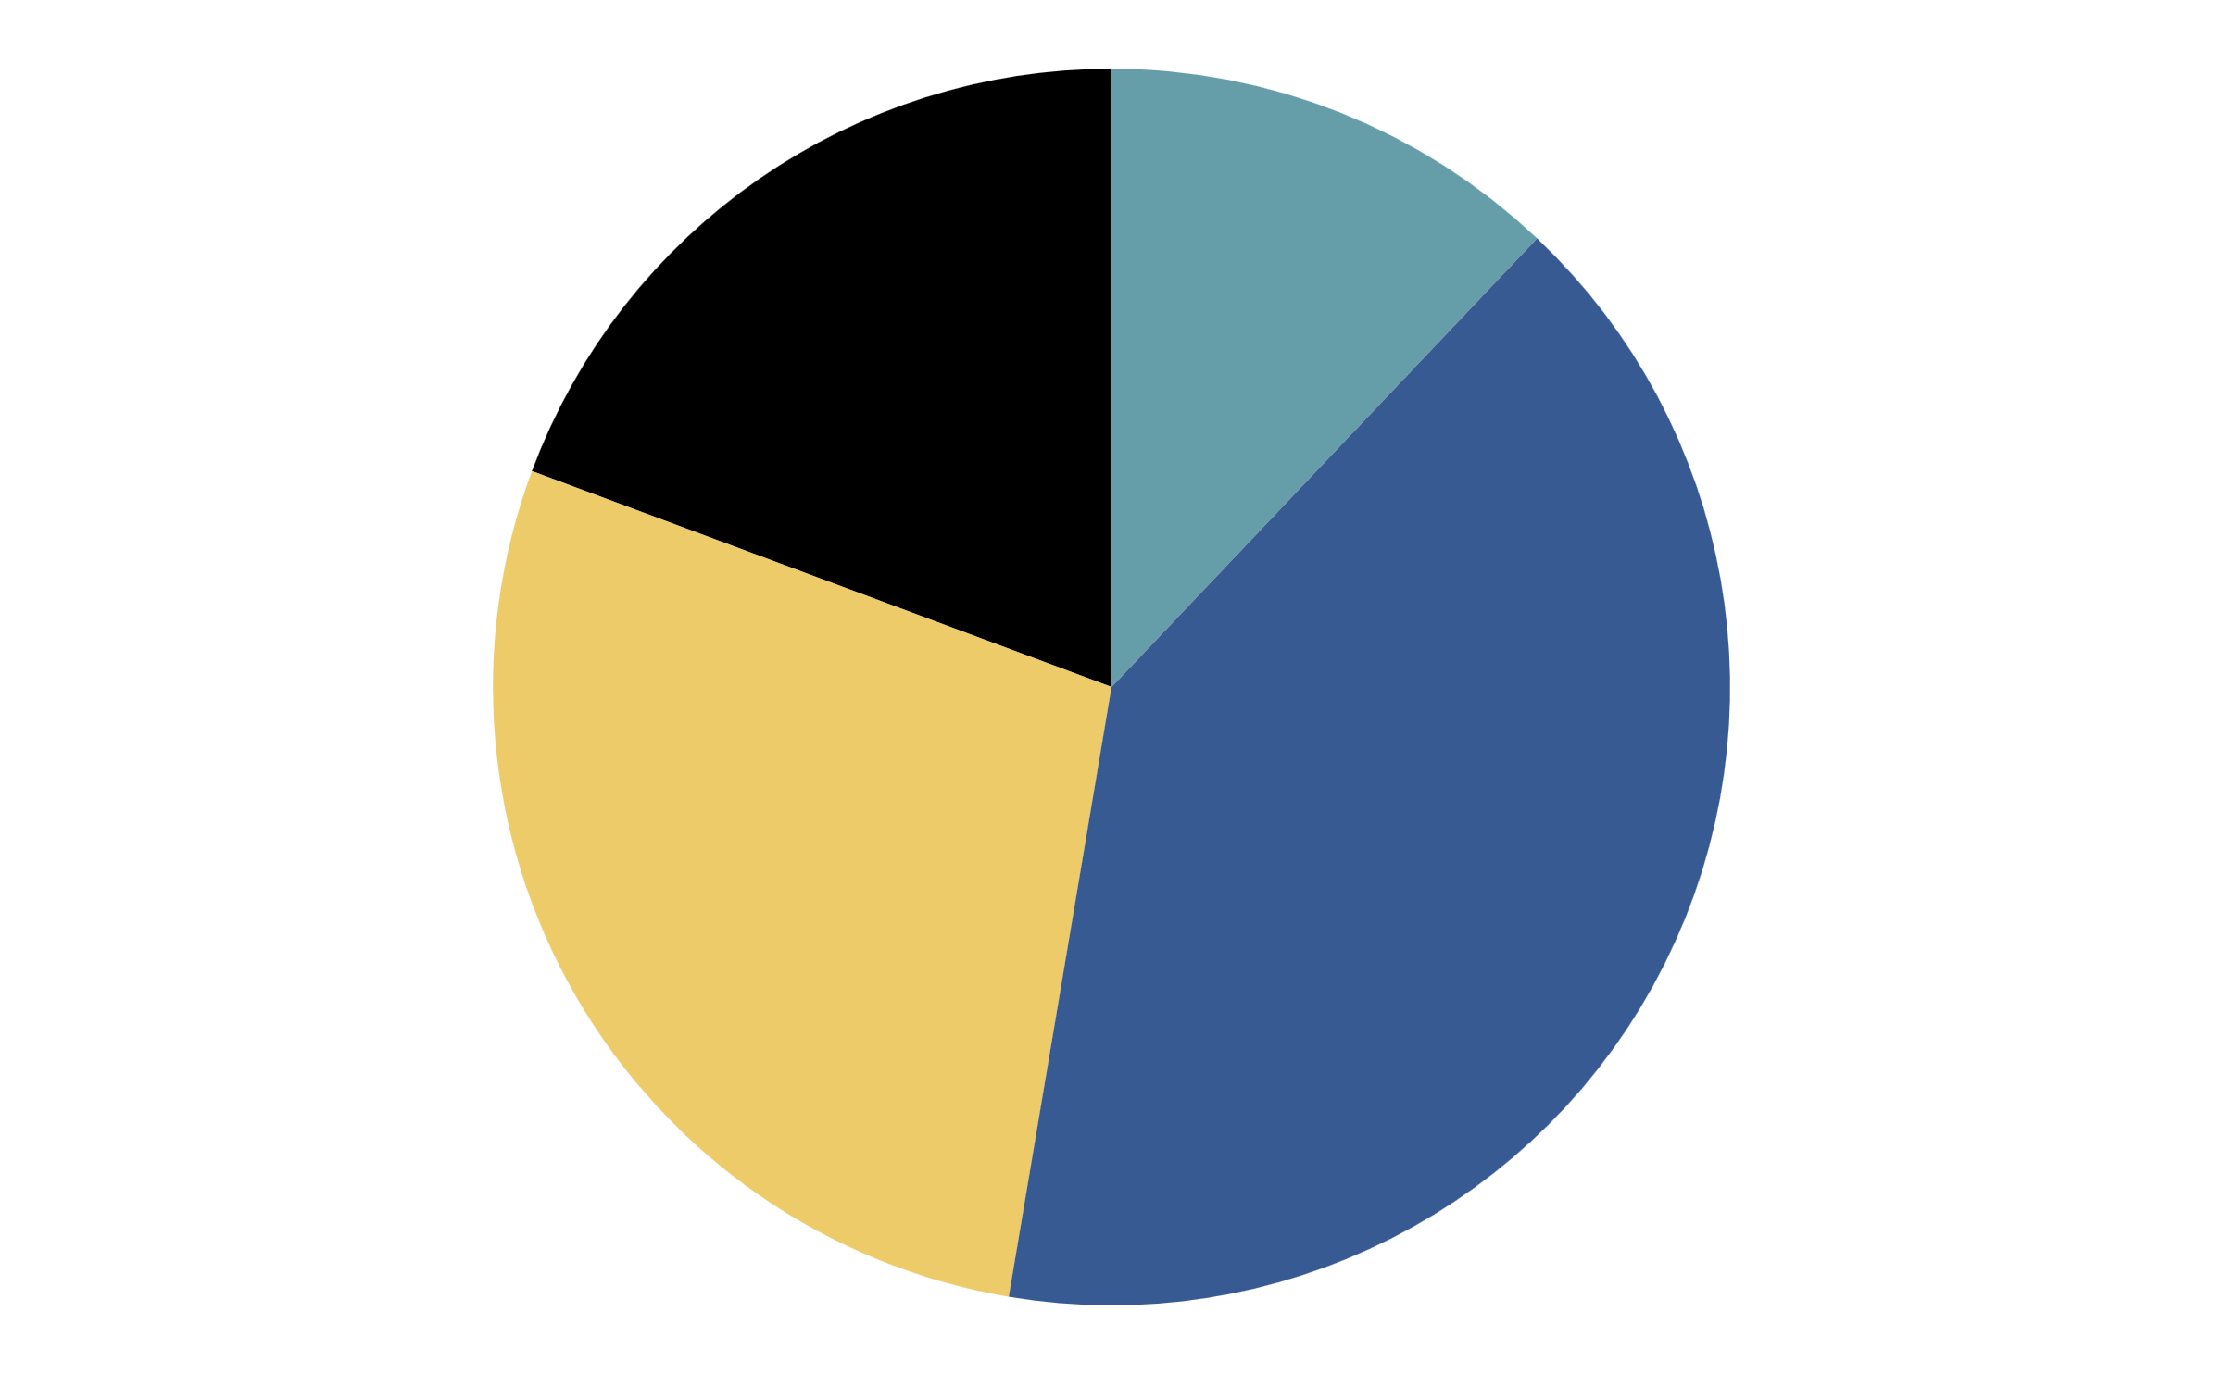
Study
Breakdown
Happy
19.3%
12.1%
Emotionally breakdown
Relaxed and enjoyable
Anxious
Worry
28%
40.6%
Nervous and painful
Slightly worried
According to the survey results, the largest number of the respondents reported they’re anxious or worried about study.

Slide 22
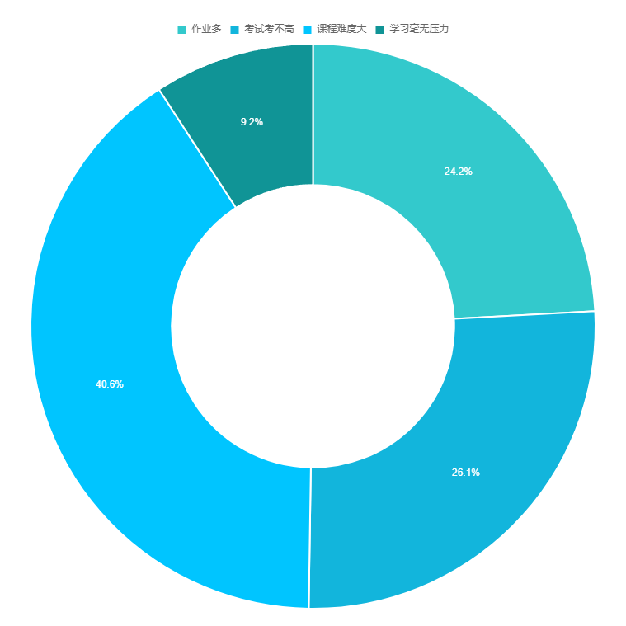
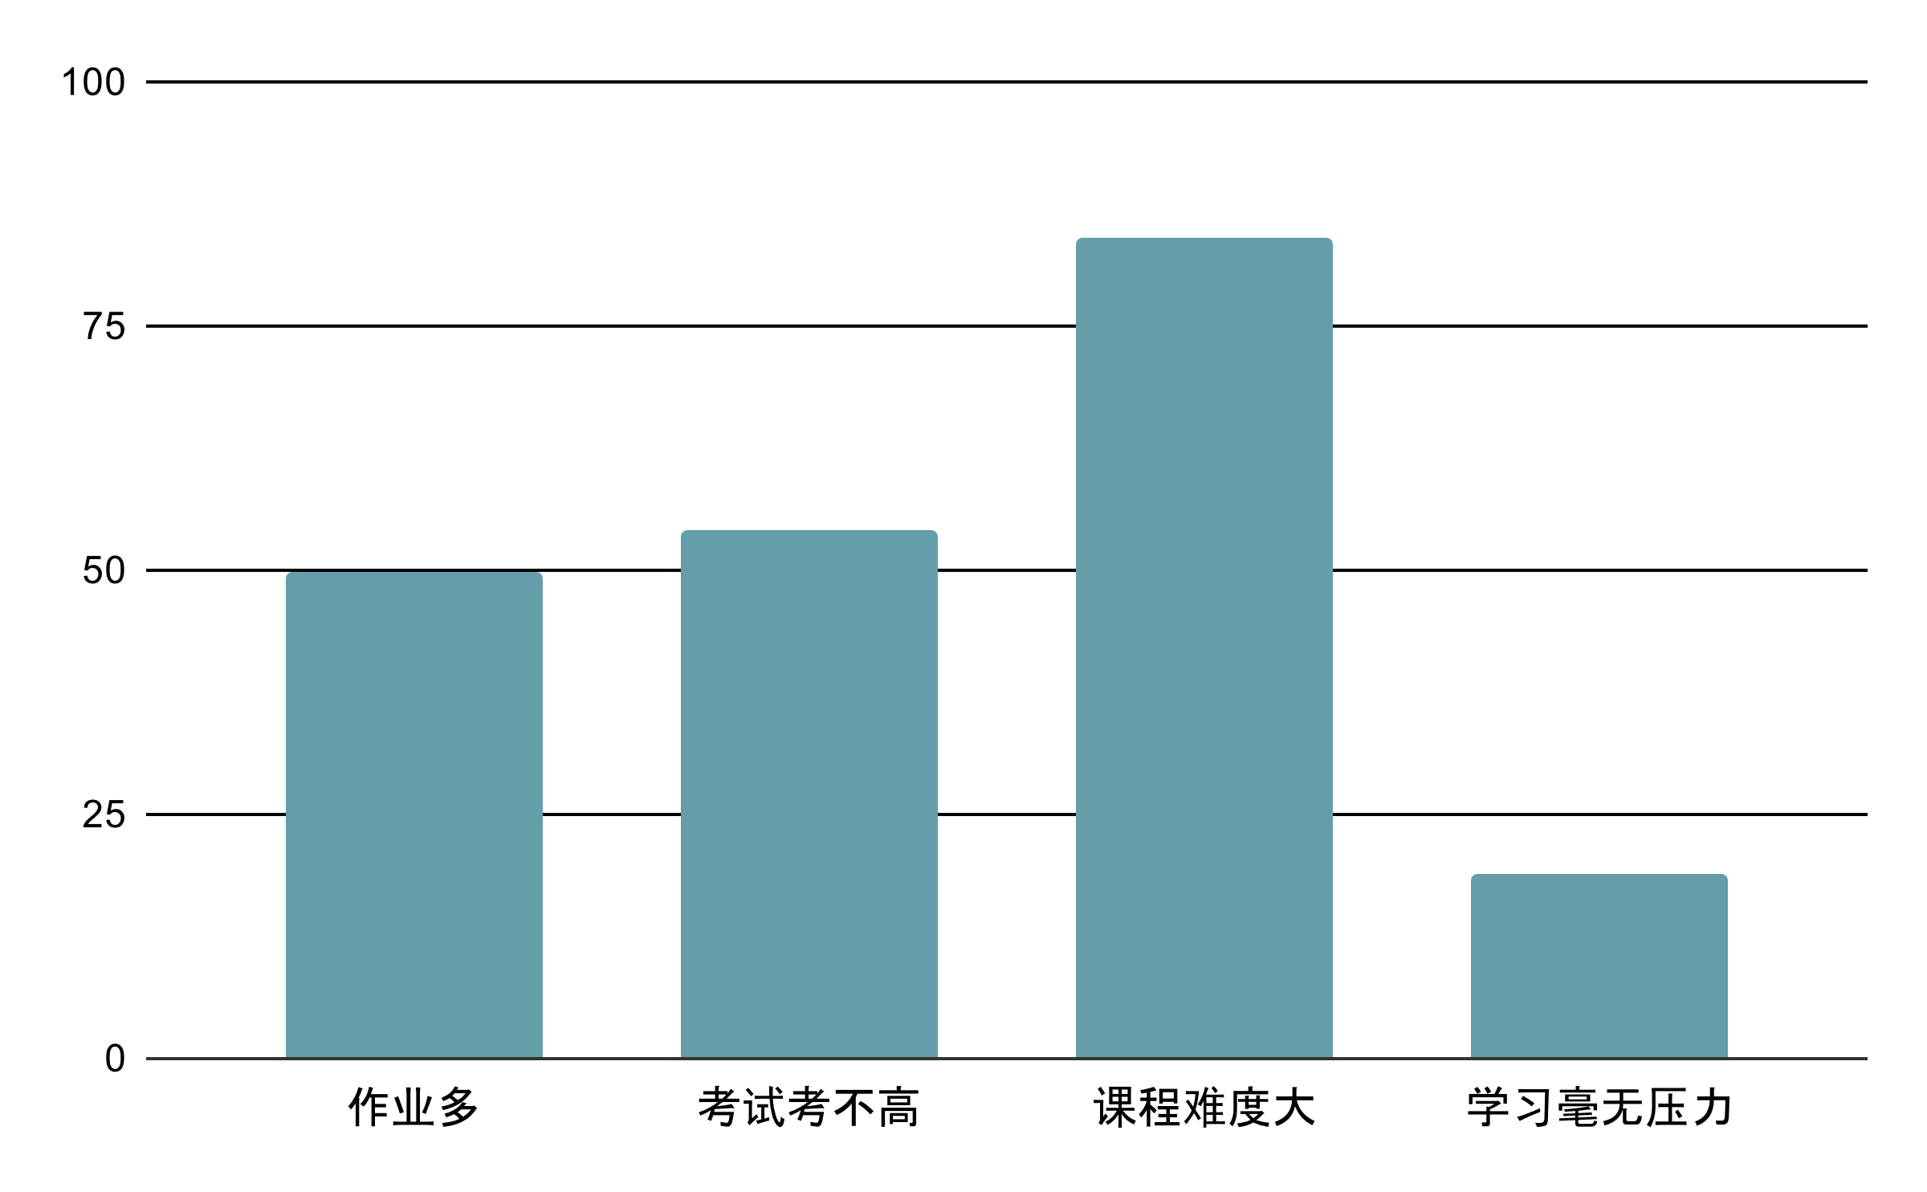
Study Pressure

Slide 23
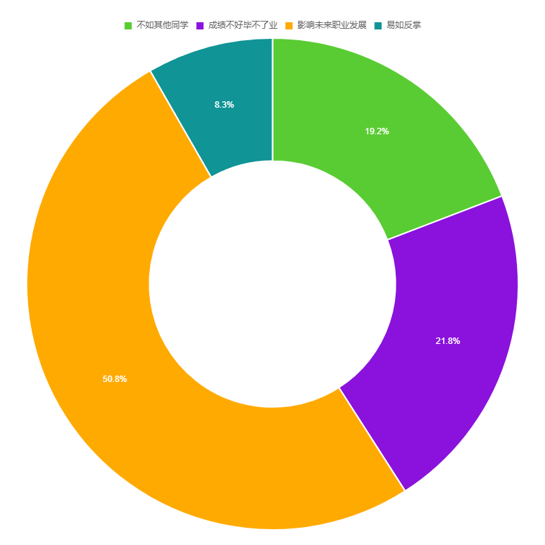
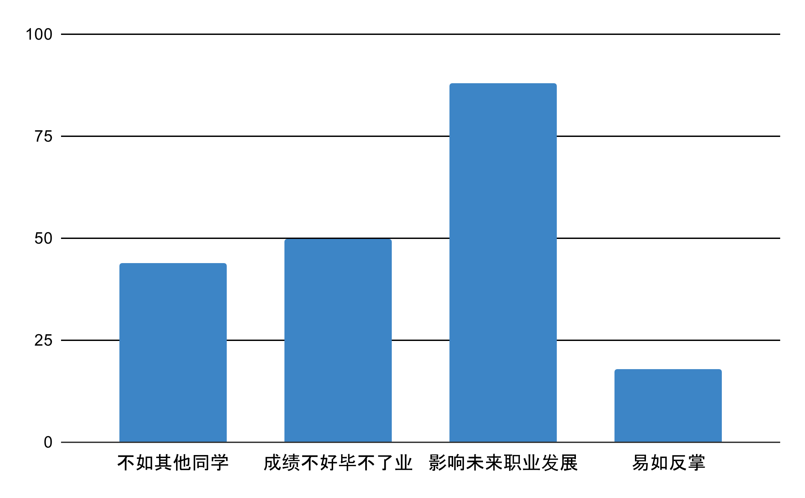
Pressure Reason

Slide 24
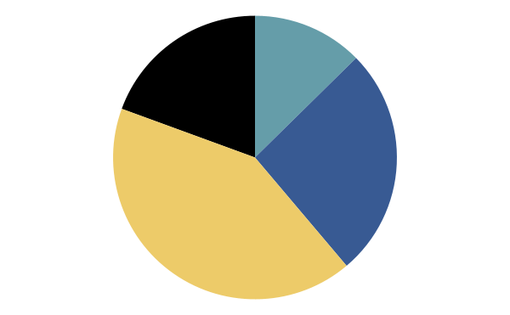
Dietary Patterns
Highly chaotic
Highly regular
19.4%
12.6%
Intermittent regularity
41.4%
Moderately regular
26.2%

Slide 25
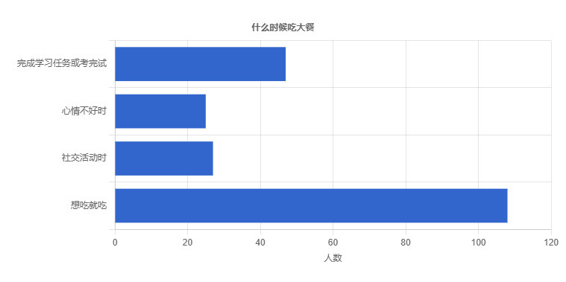
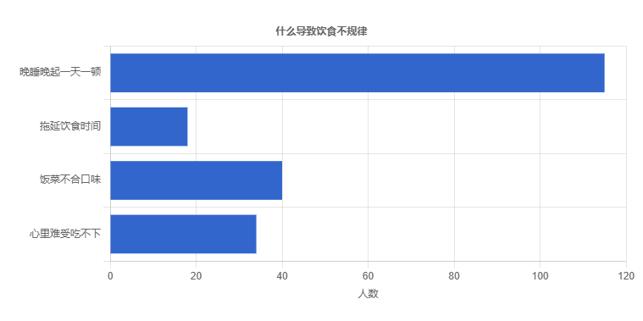
Dietary Patterns

Slide 26
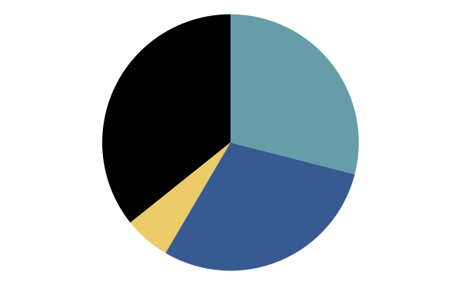

Physical condition
Healthy
A bit rough
The body is in excellent health.
There are no major health issues, but minor ailments occur sometimes.
29%
35.7%
Normal
Unhealthy
There is slight discomfort in physical condition.
5.8%
The body is frequently afflicted with illness.
29.5%

Slide 27
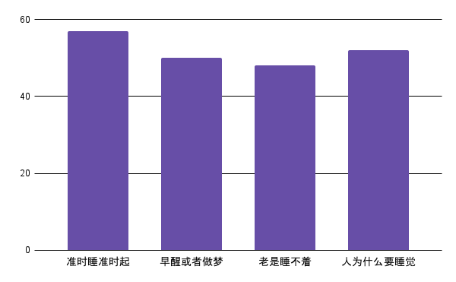
Physical condition
睡眠情况

Slide 28
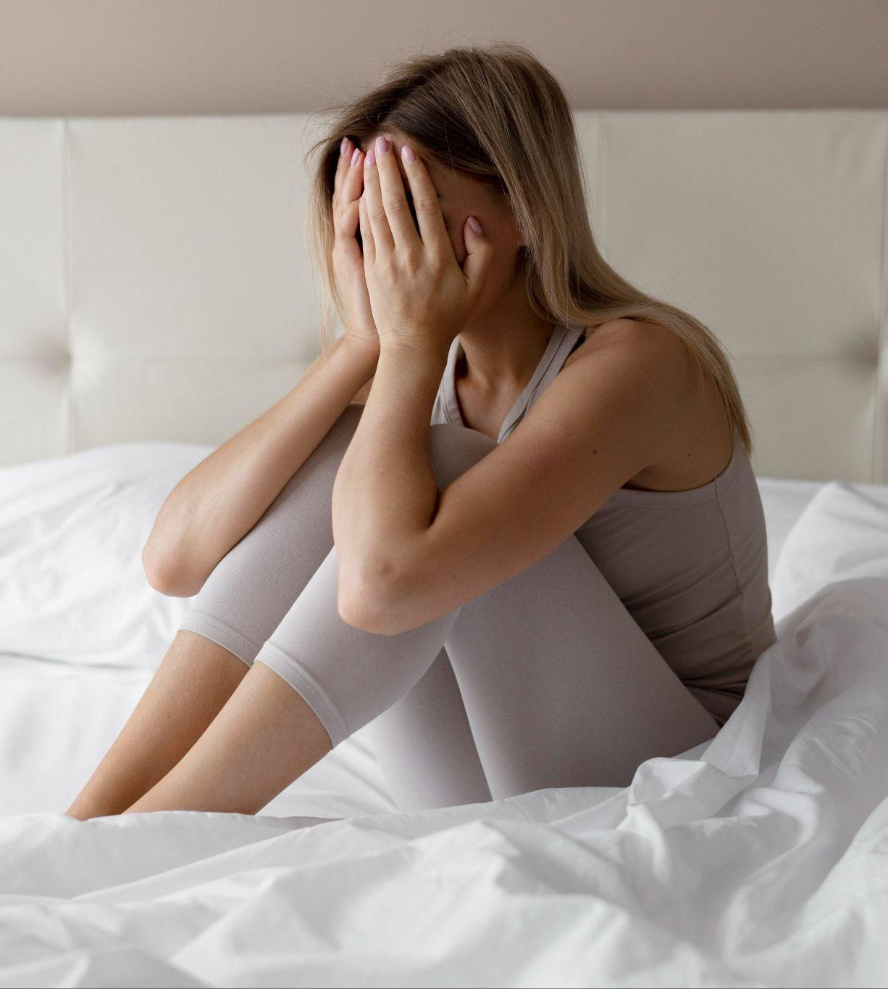
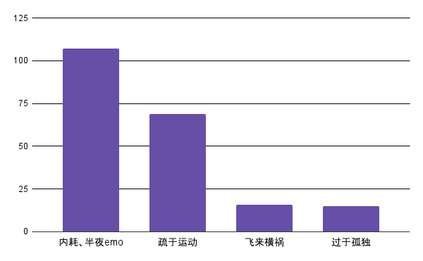
Physical condition
最能带来不良健康状况的原因

Slide 29
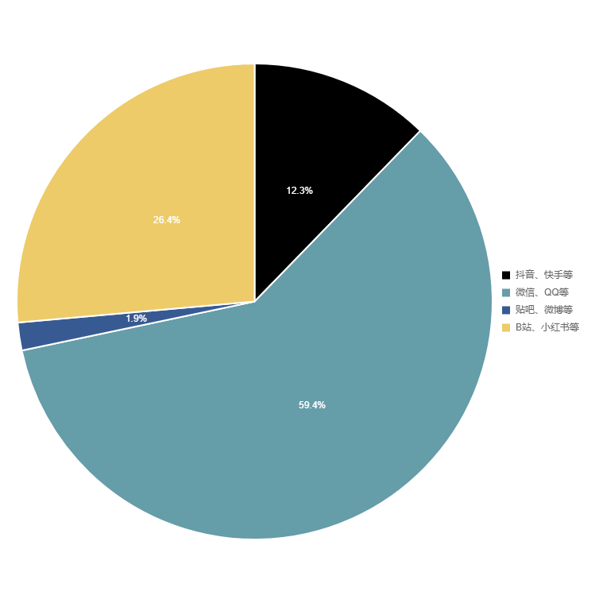


Social Network

Slide 30
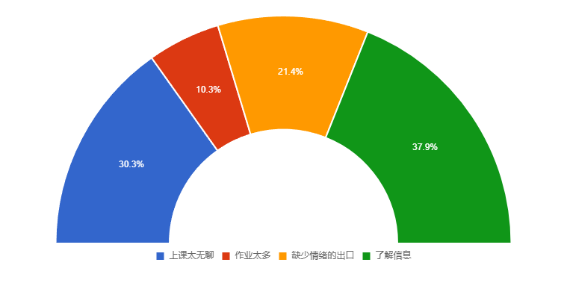
Social Network

Slide 31
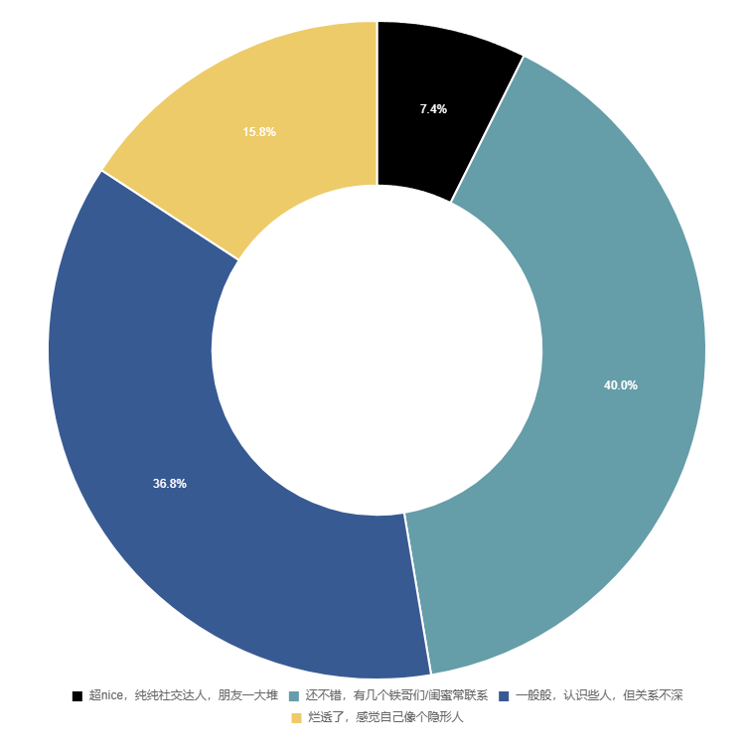
Relationships
According to survey data, nearly half of the respondents perceive their social relationships to be satisfactory.

Slide 32
AHP’s process
Matrix
Matlab
Construct pairwise comparison matrices
Calculate weight with Matlab
Check
Average
Perform consistency checks
Score the sample with a simple weighted average

Slide 33

Scoring Standards
Scale | meaning
1 | the two factors are of equal importance
3 | one factor is slightly more important than the other
5 | one factor is significantly more important than the other
7 | one factor is strongly more important than the other
9 | One factor is infinitely more important than the other
2,4,6,8 | The median factor of the two adjacent judgements above
Reciprocal | The judgment aij compared with i, then the judgment "aji = 1/aij" compared with factor j.
stronger

Slide 34


Constructing Matrices
 | Sr | Ic | Sq | Eh
Study and research(Sr) | 1 | 9 | 3 | 6
Interpersonal communication(Ic) | 1/9 | 1 | 1/3 | 1/2
Sleep quality(Sq) | 1/3 | 3 | 1 | 2
Eating habit(Eh) | 1/6 | 2 | 1/2 | 1
scoring
Questionnaire on mental state of college students

Slide 35
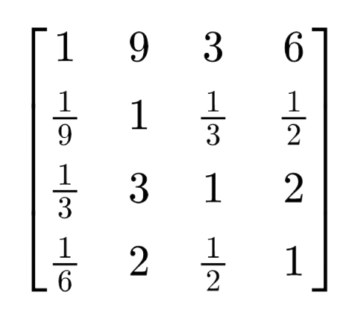
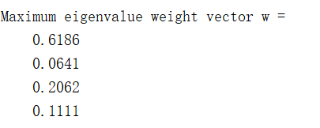

Calculating weight
input
AHP

Slide 36
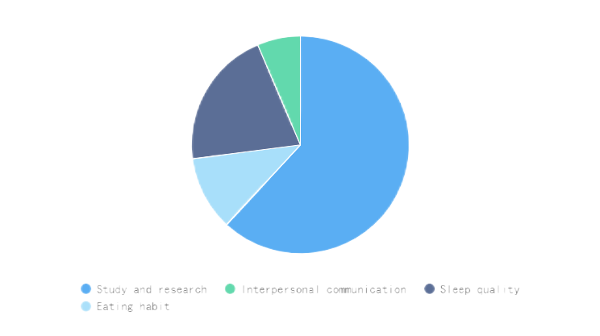
Weight proportion
Interpersonal communication
6.41%
11.11%
Eating habit
Sleep quality
Study and research
20.62%
61.86%

Slide 37

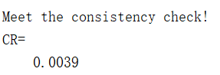
Perform consistency checks
consistency ratio (CR)<0.10
check
Ensure the validity and reliability of the matrix.

Slide 38
Weighted average
学习 | 学习分值 | 饮食 | 饮食分值 | 睡眠 | 睡眠分值 | 人际 | 人际分值
轻松愉快 | 10 | 非常规律 | 10 | 每天准时睡准时起，贼规律 | 10 | 超nice纯纯社交达人 | 10
些许烦躁 | 8 | 比较规律 | 8 | 经常早醒或者做梦 | 7 | 还不错有几个铁哥们/闺蜜 | 8
焦虑痛苦 | 5 | 间歇性规律，偶尔放纵一下 | 4 | 老是睡不着啊啊啊 | 3 | 一般般，认识些人但关系不深 | 5
难受崩溃 | 2 | 超级混乱，没有规律 | 2 | 人为什么要睡觉 | 1 | 烂透了感觉自己像个隐形人 | 2
set score
Questionnaire on mental state of college students

Slide 39
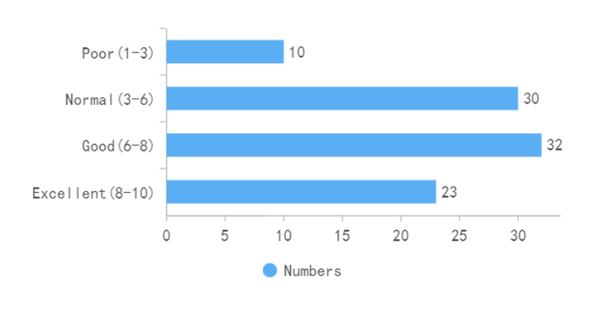
Weighted average
The final score of each user is calculated according to the weight vector obtained by AHP.

Slide 40
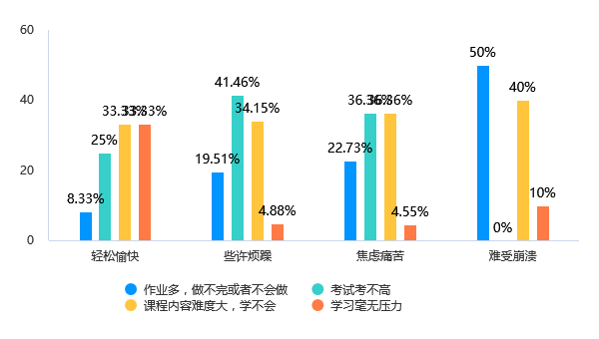
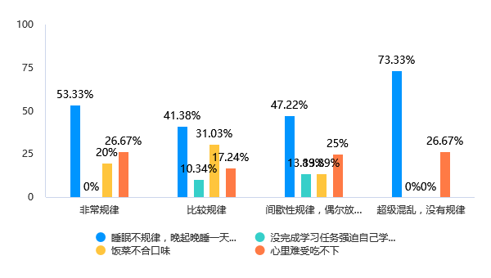
Cross-analysis

Slide 41
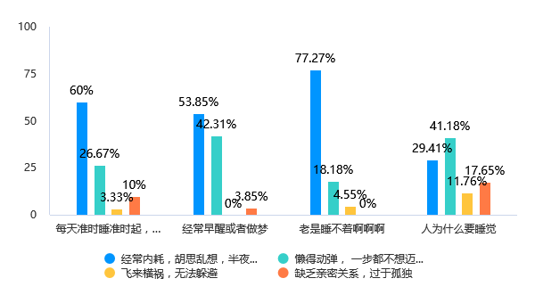
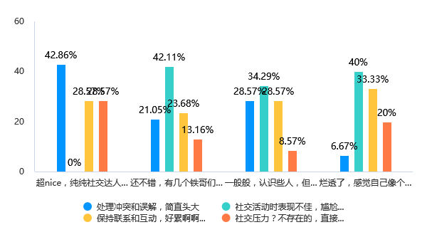
Cross-analysis

Slide 42
04
Discussion
Made by 王宇涵

Slide 43


Conclusion & Significance
take pleasure in making fun of themselves.

Slide 44
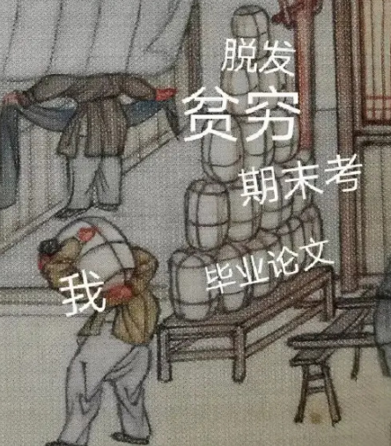

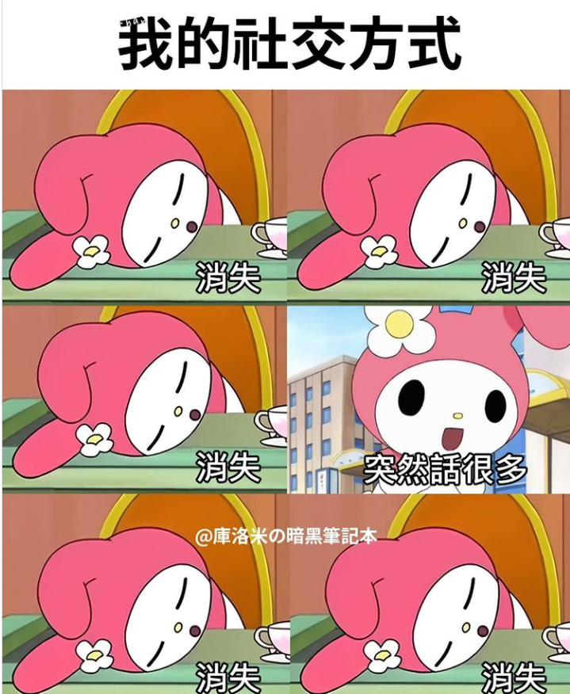

Recommendations
01 | 02 | 03 | 04
Study | Diet | Social | Sleep

Slide 45
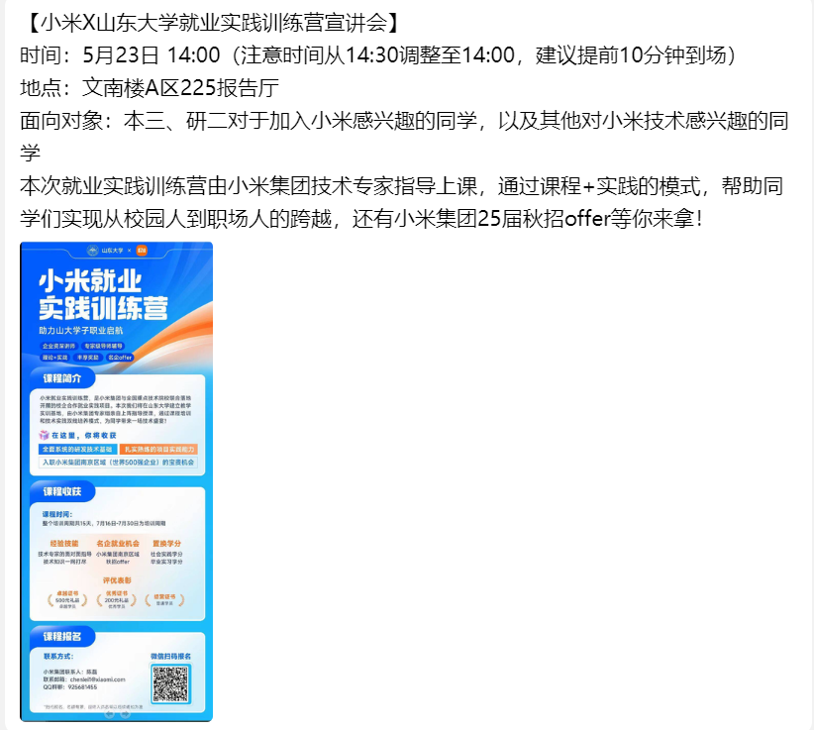
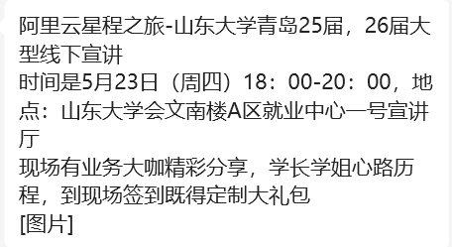
Study
Seek career counseling services

Slide 46
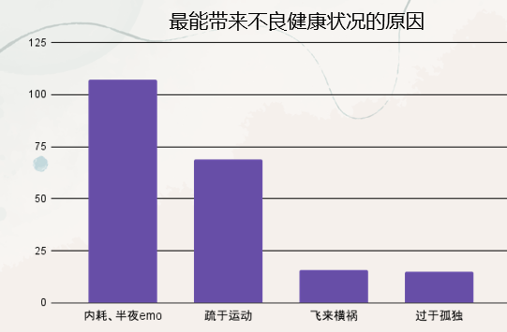

Diet & Sleep
irregular sleep is an important cause of irregular eating habits
while internal conflicts and lack of sport are the root causes of irregular sleep

Slide 47
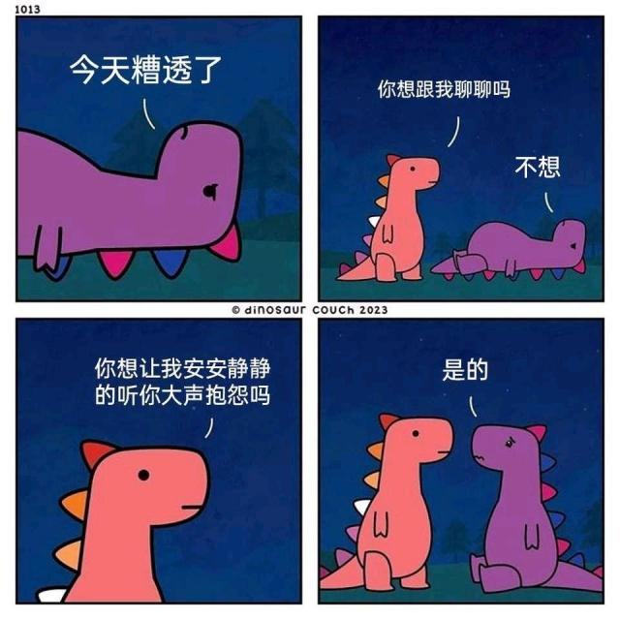
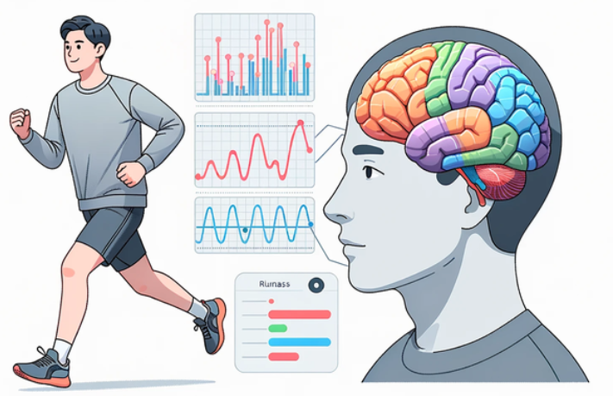

Inner Conflicts?
Connect with Others
Exercise Regularly
Get Enough Sleep

Slide 48

Social Network
Lauret Miller
Only less than half of the people believe they have relatively good social relationships
“We are born alone, we die alone, and in between, we live through love and friendship”

Slide 49


Social Network
Accept Others
Accept Yourself

Slide 50
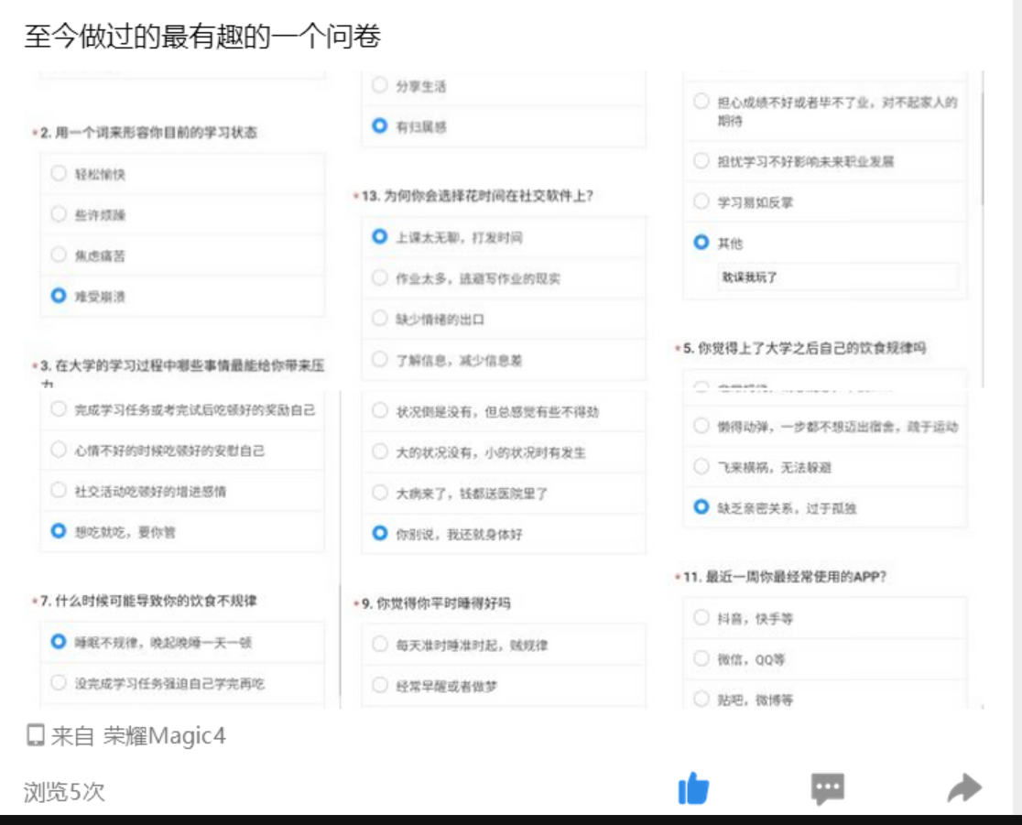

Acknowledgement
Thank you to everyone!

Slide 51
References
[1]Ren, Jiali. (2019). Analysis of Psychological Characteristics and Countermeasures of Post-2000 College Students. Journal of Shanxi Finance and Taxation Vocational College, 21(04), 71-77.
[2]Chinese Academy of Sciences Institute of Psychology, Social Sciences Academic Press. (2022). Report on the Mental Health Status of Chinese College Students in 2022.
[3]Ma, Chang. (2024). Analysis of Strategies to Enhance College Students' Psychological Health Literacy under the Concept of "Five Education". Cai Zhi, (16), 113-116.
[4]Secure a Decisive Victory in Building a Moderately Prosperous Society in All Respects and Strive for the Great Success of Socialism with Chinese Characteristics for a New Era
[5]Niu, K. (2021). The Practical Application of Cross-Analysis and Variance Analysis in Teaching. Modern Commerce Industry, 42(15), 148. doi:10.19311/j.cnki.1672-3198.2021.15.069.
[6]Ye, X. (Ed.). (Year of Publication). Basic Tutorial on Statistical Data Analysis [M]. Beijing: Renmin University of China Press.

Slide 52
Thanks!
Reporter：王奕澄，郑章庆，丁嘉晖，郭琪，王宇涵

